Slide 1
Anonymous P2P Network

Slide 2
Our Team
TEAM:​
PEDDI NAGA HARI TEJA – CS19BTECH11021​
SHAIK MOHAMMED SAYEED – CS19BTECH11004​
B.V.S.GNANESWAR - CS19BTECH11007​
BEDARAKOTA AMOGH - CS19BTECH11031​
VEMULAPALLI ADITYA – CS19BTECH11025​
GANTASALA NAGA ANEESH AJAROY - CS19BTECH11010​

Slide 3
OUR AIM
TO CREATE A P2P NETWORK WHERE WE CAN ABLE TO SEND AND RECEIVE FILES AMONG THE PEERS ANONYMOUSLY

Slide 4
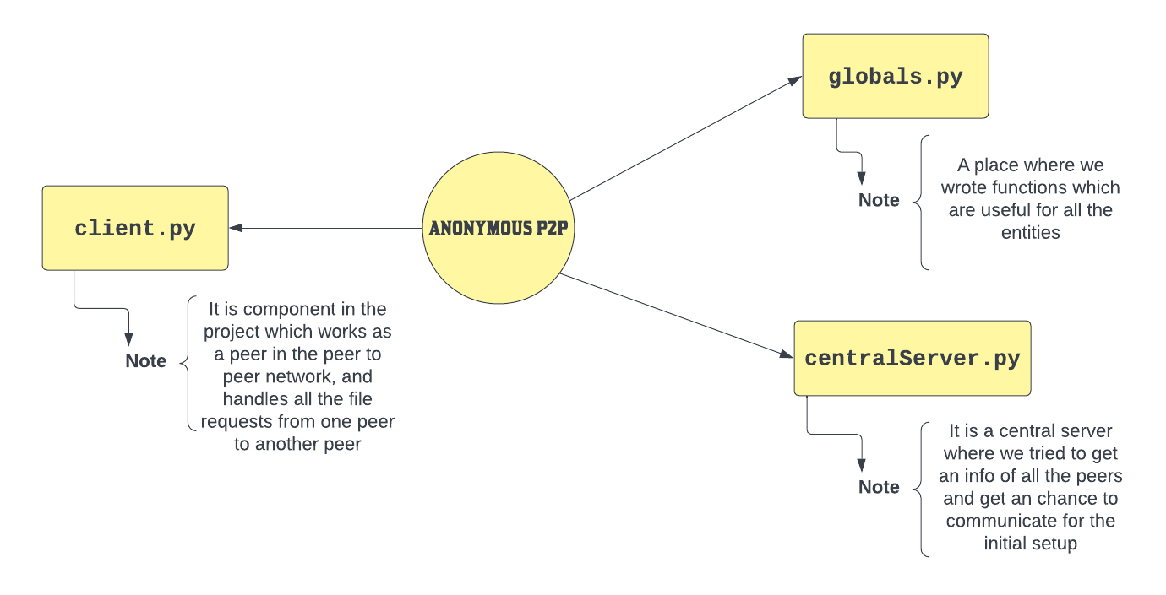
Block Diagram

Slide 5
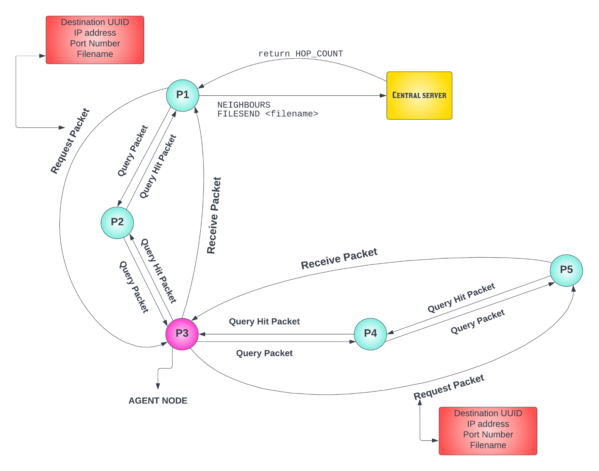
Flow
Chart

Slide 6
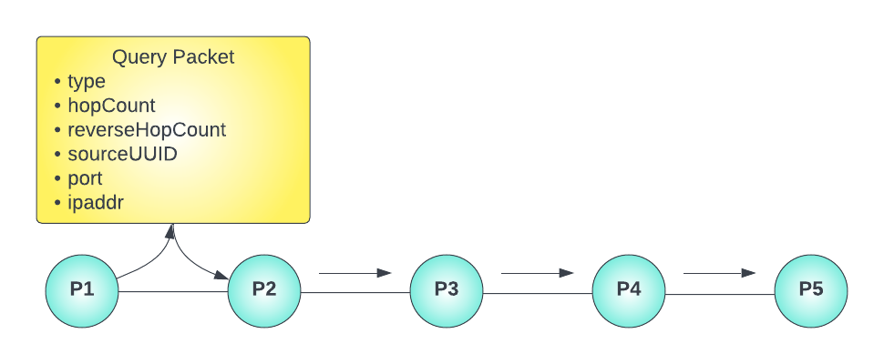
Transaction 1

Slide 7
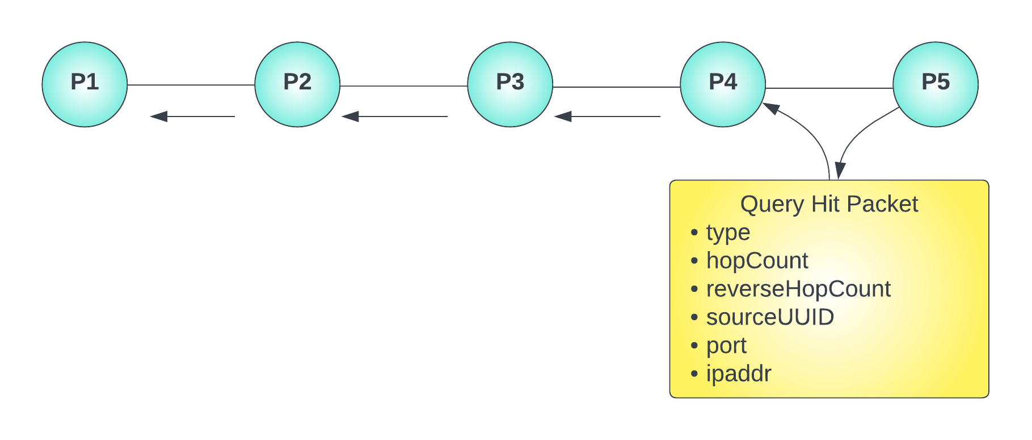
Transaction 2

Slide 8
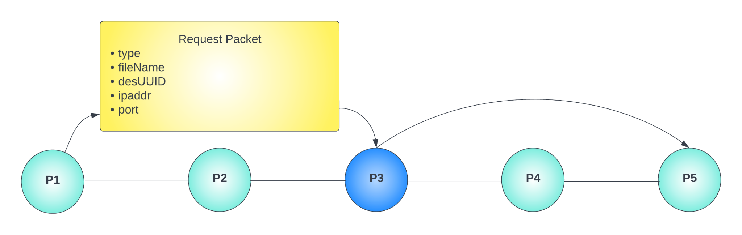
Transaction 3

Slide 9
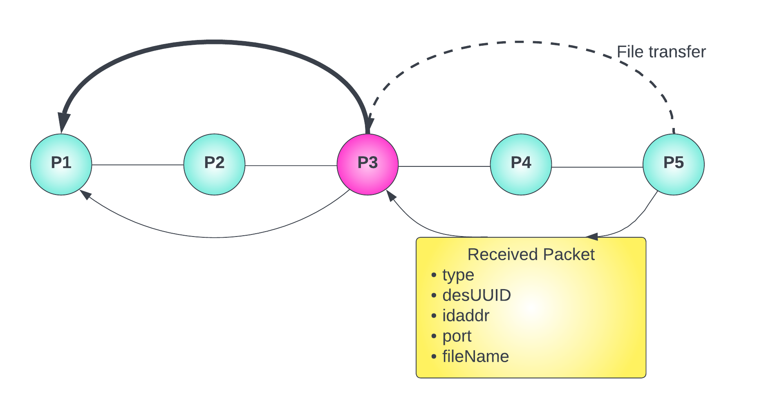
Transaction 4

Slide 10
Why we choose this and the drawbacks ?
General P2P is heavily and widely used for huge file transaction between two computer or hosts from one place to another.
To avoid this we thought of introducing anonymity in the network , so that we can send or retrieve files without any hassle
In general P2P network when we tried to send the files we usually share our address and port numbers in order to retrieve the files or send the files
If once this model is deployed , we can use this kind of networks for communication between secret agencies, army or any other government offices for privacy.
In this way we are open to everyone and there is a chance that we can exposed to outside world and some attacks may occur on us , if the system got compromised.

Slide 11
A good looking UI
Automation of sharing the UDP addresses with the neighbours
Decentralised Server
Adding the data reliability by replacing the UDP with TCP or UDP-TCP
POSSIBLE FUTURE ENHANCEMENTS

Slide 12
THANK YOU

